Slide 1

AfyaPlus Triage Engine: Turning Patient Messages into Safe, Structured Action
A resilient AI triage prototype for AfyaPlus Health July 2026

Slide 2

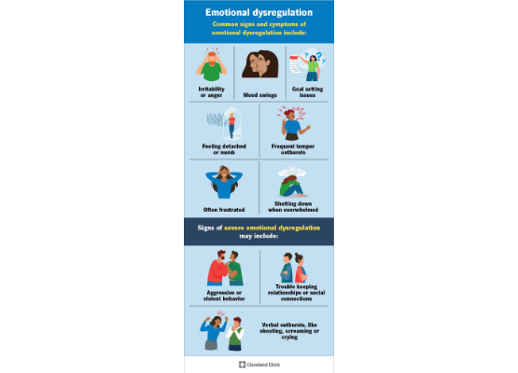
The Business Problem
•
Patients text in free-form language, but backend systems require structured data to route correctly.
•
Three critical failures identified in early testing: conversational fluff, hallucinated medical facts, and system crashes during poor connectivity.
•
Connectivity drops are a real, persistent constraint for patients across Kenya and the region.
•
The cost of failure: A missed emergency routed incorrectly, or a total system outage when a patient needs help most.

Slide 3


The Solution: A Dual-Pathway AI Pipeline
Primary Cloud AI
Local Offline Backup
Built using GPT-4o-mini for primary use. It processes patient messages quickly and accurately. If the connection fails or times out (within 4 seconds), the system instantly alerts the fallback.
Llama 3.2 running entirely offline acts as the failover. The system automatically switches to this local model with zero manual intervention if the cloud is unreachable.
"It's like having a backup generator that kicks in instantly during a power cut, ensuring patients are never left without a response."

Slide 4






Why This Model Choice
Cloud (GPT-4o-mini)
Local (Llama 3.2)
Structured Prompts
Chosen for strong reasoning at low cost and low latency. Highly suitable for producing accurate, real-time patient triage.
Lightweight enough to run on modest hardware without the internet. Critical for ensuring absolute reliability in low-connectivity areas.
Provides a clear "role", forcing step-by-step reasoning with strict, hard-coded rules against giving medical advice to protect safety.

Slide 5


Demonstrating It Works
Before (Unstructured)
After (Final Prototype)
Early iterations using basic instructions produced inconsistent responses, conversational fluff, and posed major safety risks due to uncontrolled data formats.
The final, hardened instructions produce a clean, consistent, safe structured data response every single time, ready for immediate backend routing.
The system was heavily tested against both normal patient messages and deliberately adversarial inputs (e.g., trying to trick the AI into ignoring safety rules), and it held up successfully.

Slide 6
Operational Risks & Limitations
Not a Diagnostic Tool: This is strictly a routing/triage tool. It deliberately refuses to calculate medication doses or suggest treatments, by design, for patient safety.
Speed vs. Reliability: Local/offline AI responses are slightly slower and less consistently formatted than cloud responses—a necessary tradeoff for guaranteed uptime.
Adversarial Actors: Instruction-based safety rules heavily reduce, but do not 100% eliminate, the risk of a determined bad actor bypassing the system. Production needs traditional safeguards.
Network Constraints: Network dependency remains a real-world constraint that this fallback design mitigates gracefully, but does not remove entirely.

Slide 7
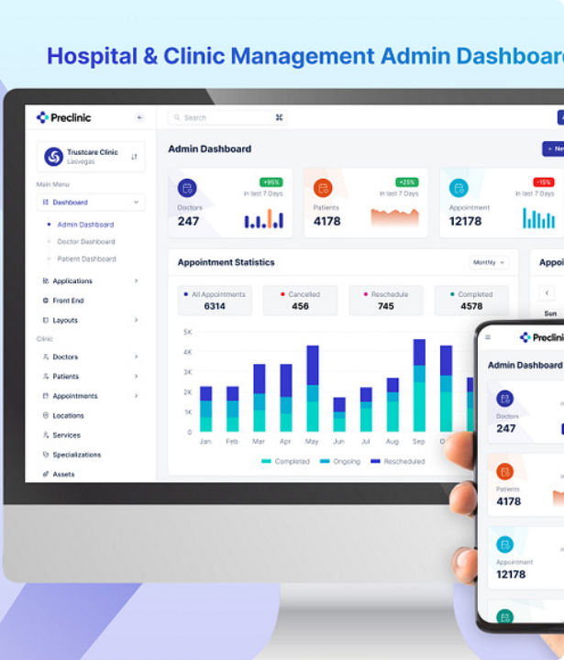
Business Impact & Next Steps
We now have a working prototype demonstrating that messy patient messages can be reliably converted into safe, structured, backend-ready triage decisions, even during total network failures.
Next Steps
•
Connect to a real backend routing system.
•
Expand testing with real (anonymized) patient message data.
•
Formalize a comprehensive safety and compliance review before any clinical deployment.

